Slide 1
Face Transformer Rethinking model incorporating EfficientNet into ViT

Slide 2
INTRODUCTION
Recently there has been a growing interest in Transformer not only in NLP but also in Computer Vision. The transformer can be used in Face Recognition and it is better than CNNs. Therefore, we investigate the performance of Transformer models in Face Recognition. Considering the original Transformer may neglect the interpatch information, we modify the patch generation process and make the tokens with sliding patches that overlap with each other. The models are trained on CASIA-WebFace databases, and evaluated on several mainstream benchmarks, including LFW databases. We demonstrate that Face Transformer models trained on a large-scale database, CASIA-WebFace, achieve comparable performance as CNN with a similar number of parameters and MACs. The Face-Transformer mainly uses ViT (Vision Transformer) architecture. Now we demonstrate if we can transfer learn and fine-tune the model with EfficientNet & merge it into ViT to get a better result.

Slide 3
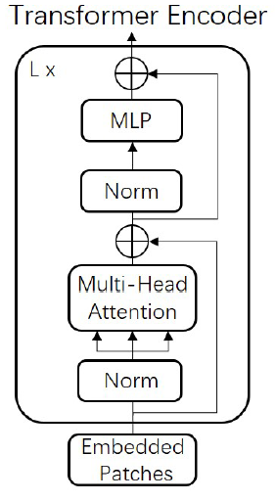
What is Transformer?
A transformer is a type of deep learning model that uses Artificial Neural Networks to process sequential input data. Transformers are used for Natural Language Processing (NLP) and Computer Vision (CV) tasks.
Transformers use a mechanism called Self-Attention to process input data. This mechanism helps identify how distant data elements influence and depend on one another. Transformers can process the entire input data at once, capturing context and relevance.
Transformers can capture long-range dependencies and relationships between patches in the image more effectively by using self-attention rather than convolutions.

Slide 4
Vision Transformer (ViT)
A Vision Transformer (ViT) is a type of neural network architecture for computer vision tasks that utilizes the transformer architecture, originally introduced for natural language processing and computer vision tasks.
Vision Transformer (ViT) is a type of neural network architecture for computer vision tasks like image classification, object detection, and image segmentation. It takes inspiration from the Face Evolve Model - https://github.com/ZhaoJ9014/face.evolve, a high-performance Face Recognition Library based on PaddlePaddle & PyTorch.
Face Transformer for Recognition is a specific deep learning architecture designed for facial recognition tasks, inspired by ViT and Face-Evolve. It represents a novel approach that merges the strengths of traditional Convolutional Neural Networks (CNNs) with the powerful self-attention capabilities of Transformers.

Slide 5
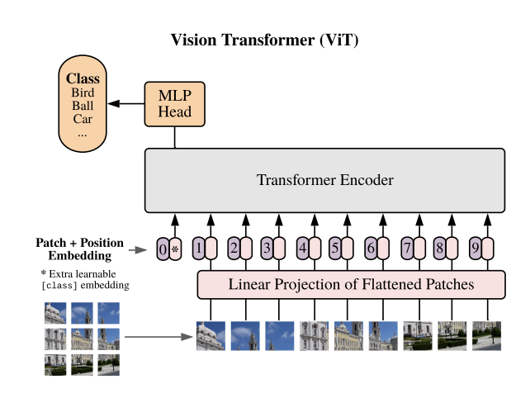

Slide 6
Salient Features of Vision Transformer
Features | Description
Self-Attention Mechanism | ViT eschews the traditional convolutional layers of CNNs and instead relies on the powerful self-attention mechanism. This mechanism allows each patch in an image to "attend" to all other patches, effectively analyzing their relationships and dependencies
Patch-based Processing | Instead of operating on the entire image at once, ViT divides it into smaller, overlapping patches. Analyzing smaller patches is computationally cheaper than processing the entire image, making ViT potentially more efficient.
Intoducing Loss Functions | ViT introduces cross entropy based loss functions like CosFace, ArcFace, SFaceLoss, SoftMax etc.
Local and global feature extraction | Patches capture local details, while their overlap allows interaction and understanding of global relationships.

Slide 7
Objectives
● To learn a representation of face images that is invariant to variations in lighting, pose, and expression.
● To achieve state-of-the-art results on face recognition benchmarks by fine-tuning with EfficientNet and introduce the model into ViT.
● To be robust to variations in the quality of the input images by evaluating LFW evaluation databases.
● To make it efficient in terms of computational cost and memory.

Slide 8
Proposed Solution
Solutions | Description
Using more powerful hardware | Face transformer models can be made more computationally efficient by using more powerful hardware, such as GPUs and TPUs
Using more advanced techniques | Transfer Learning and Fine-Tuning through EfficientNet & ViT.
Collecting more data | The performance of face transformer models could also be improved by collecting more data. This could be done by collecting data from a wider variety of sources.

Slide 9
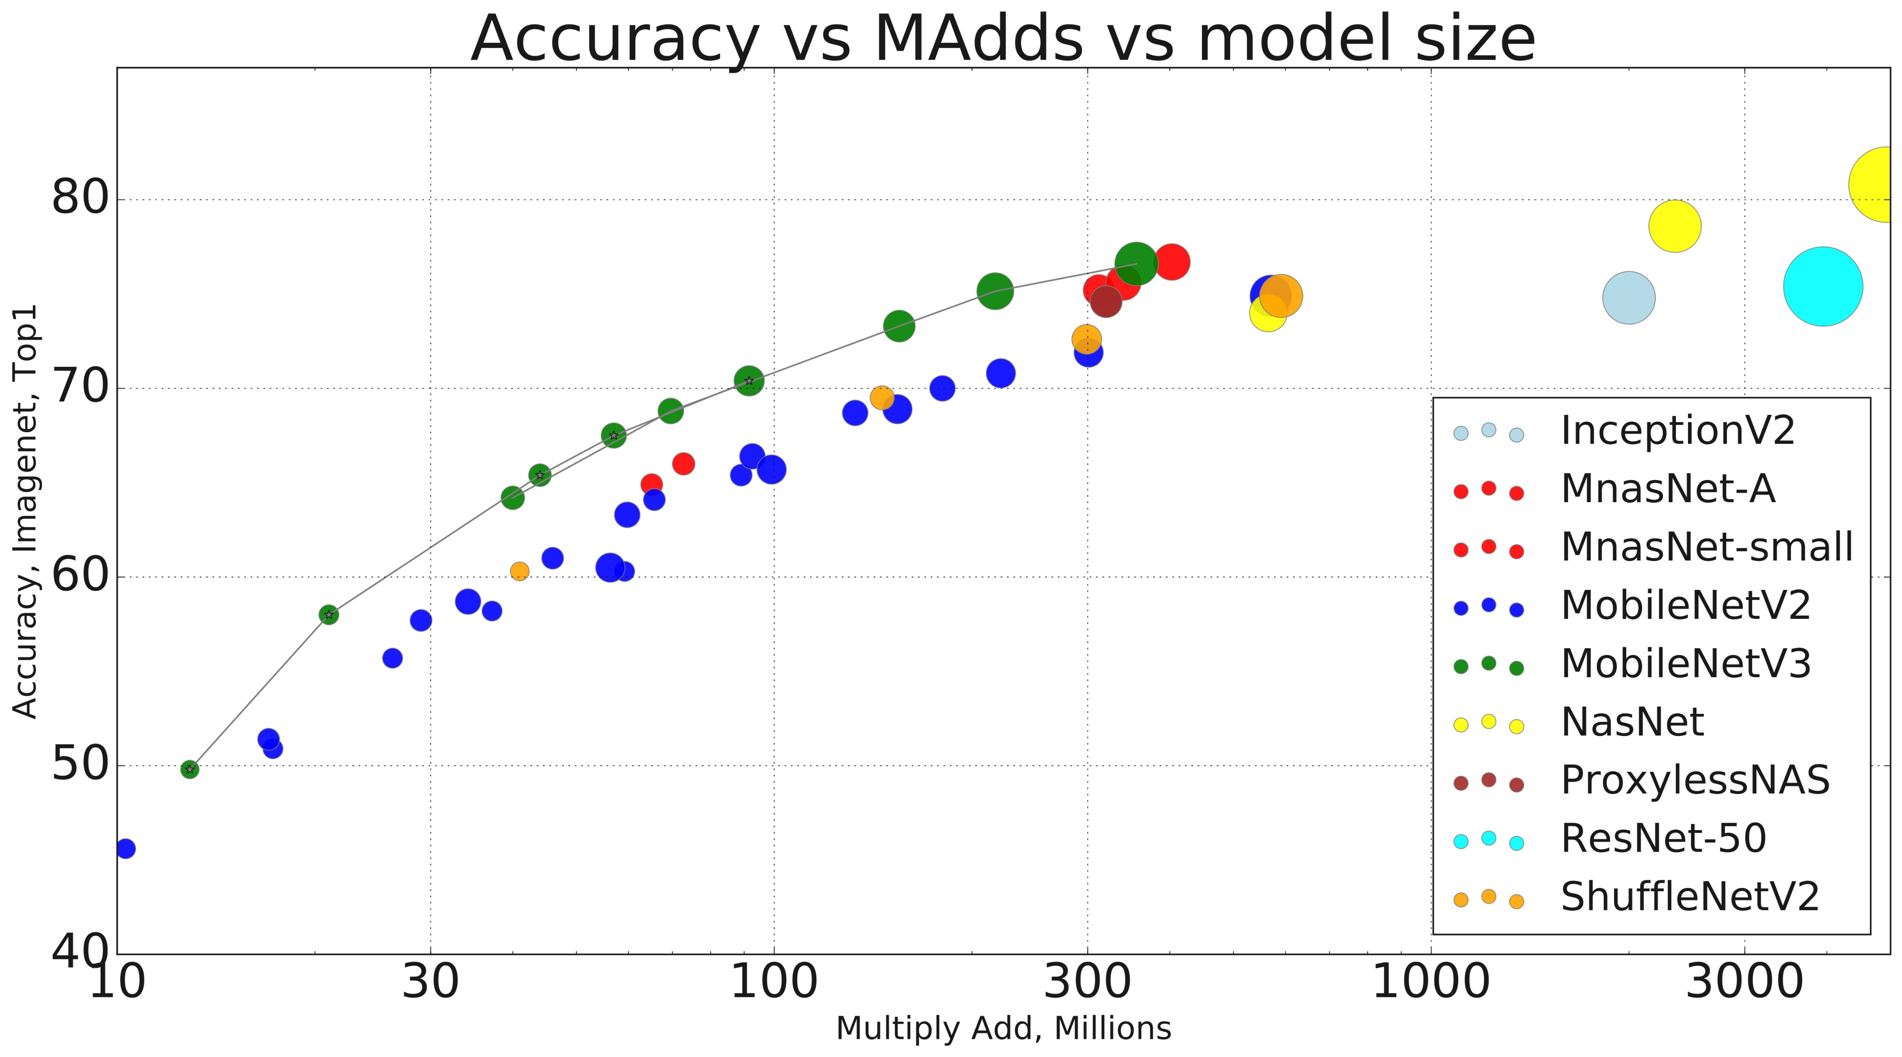
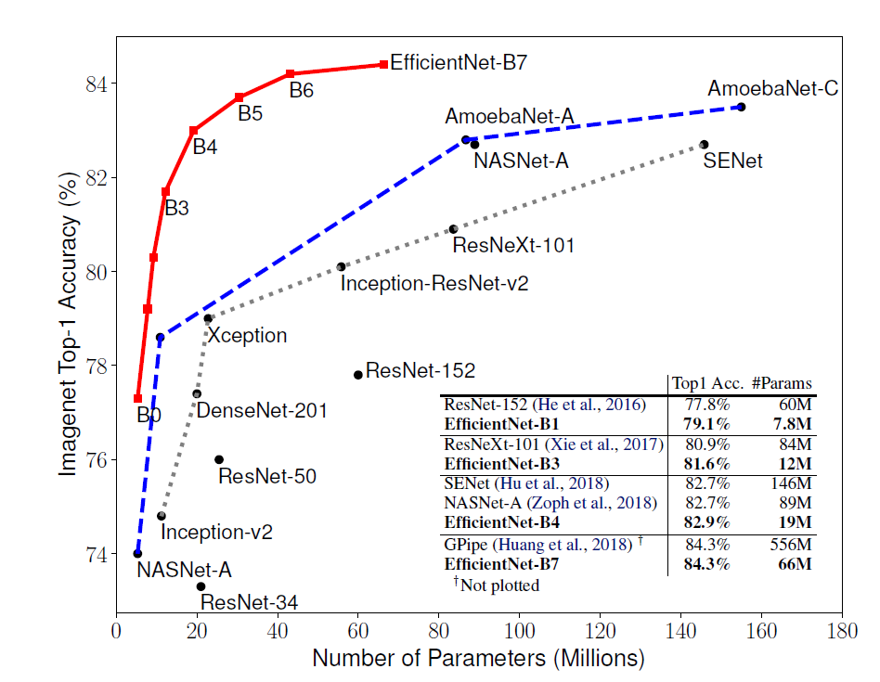
Why EfficientNet?
Two successful model of computer vision (CV) related works are – MobileNetV1 (2017), MobileNetV2 (2018), MobileNetV3 (2019) & EfficientNetV1 (2019), EfficientNetV2 (2021). Convolutional Neural Networks (ConvNets) are commonly developed at a fixed resource budget and then scaled up for better accuracy if more resources are available. EfficientNet systematically studies model scaling and identifies that carefully balancing network depth (d), width (w), and resolution (r) can lead to better performance. Neural architecture searches to design a new baseline network and scale it up to obtain a family of models, called EfficientNets, which achieve much better accuracy and efficiency than previous ConvNets. In particular, our EfficientNet achieves state-of-the-art 84.3% top-1 accuracy on ImageNet, while being 8.4x smaller and 6.1x faster on inference than the best existing ConvNet.

Slide 10
MobileNetV2 vs EfficientNet
Aspect | MobileNetV2 | EfficientNet
Architecture | Depthwise separable convolutions, linear bottlenecks | Uniform scaling of depth, width, and resolution
Efficiency | Efficient for mobile and embedded vision applications | Achieves high accuracy while maintaining efficiency
Performance | Balanced accuracy, speed, and model size | Generally outperforms MobileNetV2 on benchmarks
Model Size | Smaller and more lightweight | Larger, but offers state-of-the-art performance
Computational Resources | Less computationally intensive | More computationally intensive, but efficient scaling
Deployment | Suitable for resource-constrained environments | Better suited when slightly larger models can be accommodated
Established | Longer established, widely used | Relatively newer but rapidly gaining popularity

Slide 11
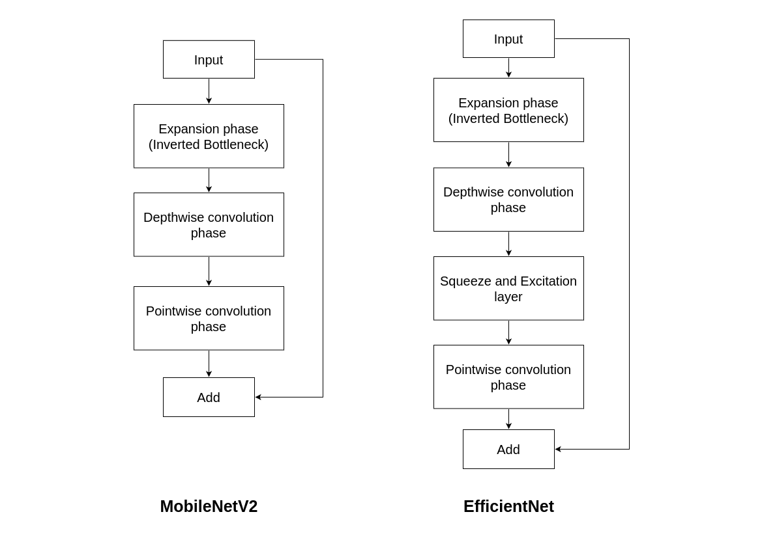
MobileNetV2 vs EfficientNet

Slide 12
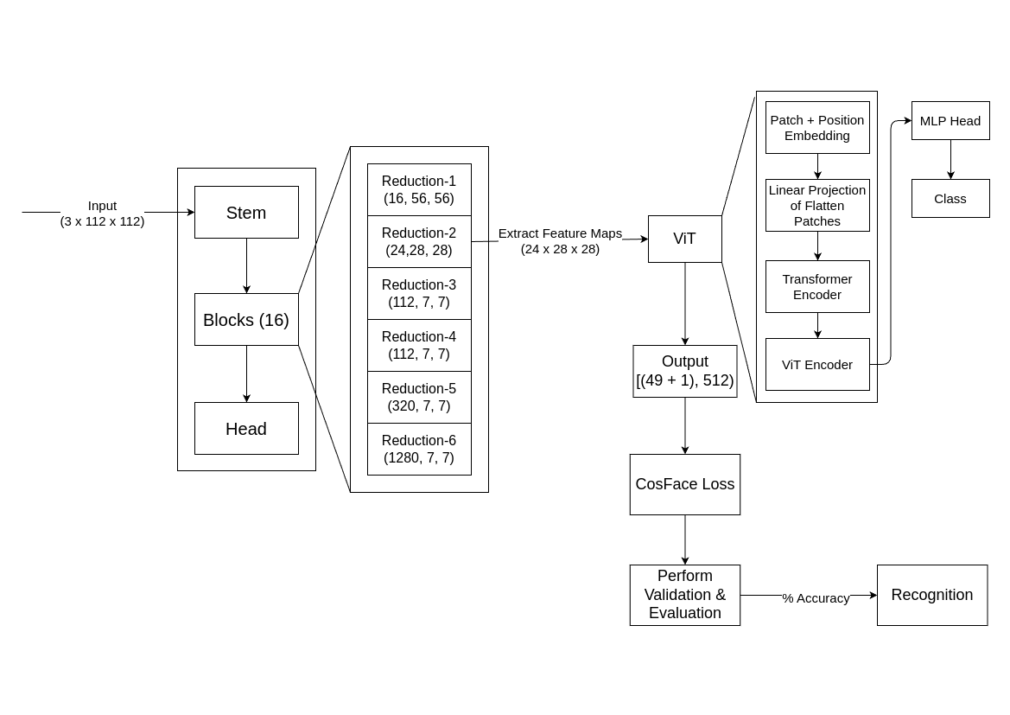
Our Model Architecture

Slide 13
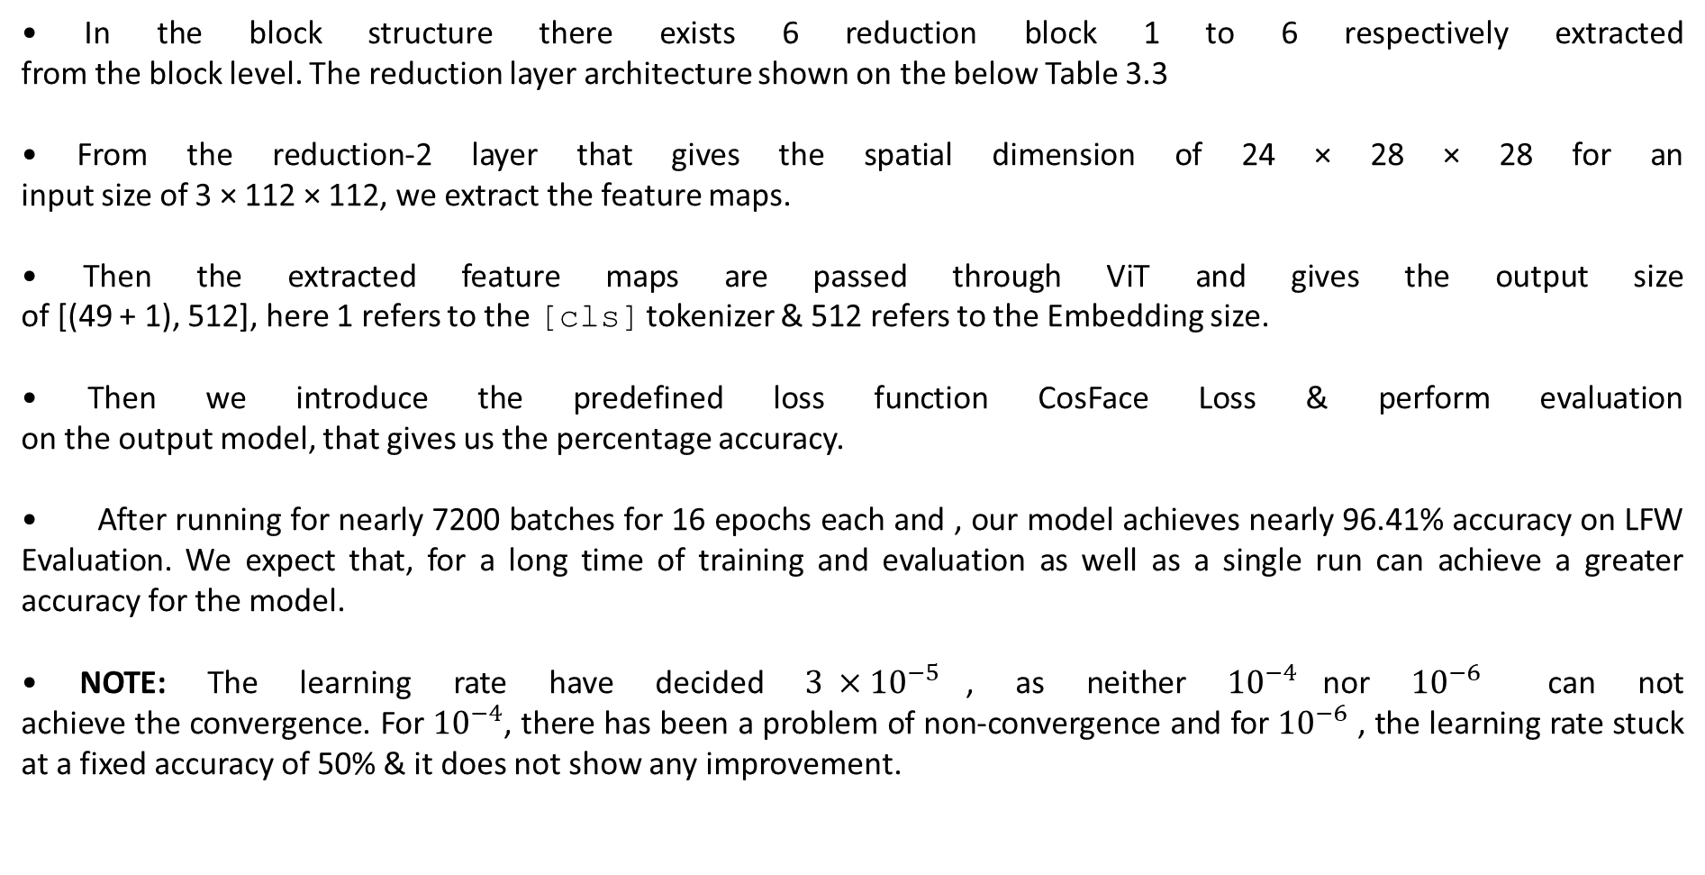
Explanation of Model Architecture
• In the block structure there exists 6 reduction block 1 to 6 respectively extracted from the block level. The reduction layer architecture shown on the below Table 3.3
• From the reduction-2 layer that gives the spatial dimension of 24 × 28 × 28 for an input size of 3 × 112 × 112, we extract the feature maps.
• Then the extracted feature maps are passed through ViT and gives the output size of [(49 + 1), 512], here 1 refers to the [cls] tokenizer & 512 refers to the Embedding size.
• Then we introduce the predefined loss function CosFace Loss & perform evaluation on the output model, that gives us the percentage accuracy.
• After running for nearly 7200 batches for 16 epochs each and , our model achieves nearly 96.41% accuracy on LFW Evaluation. We expect that, for a long time of training and evaluation as well as a single run can achieve a greater accuracy for the model.
• NOTE: The learning rate have decided ${3 ×10}^{−5}$, as neither ${10}^{−4}$nor ${10}^{−6}$ can not achieve the convergence. For ${10}^{−4}$, there has been a problem of non-convergence and for ${10}^{−6}$ , the learning rate stuck at a fixed accuracy of 50% & it does not show any improvement.

Slide 14
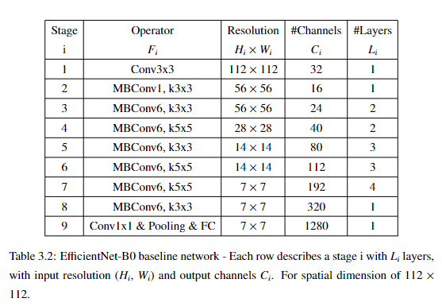
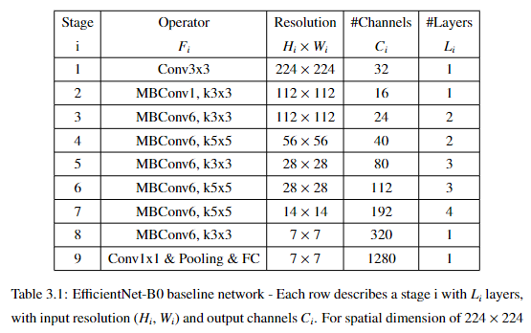
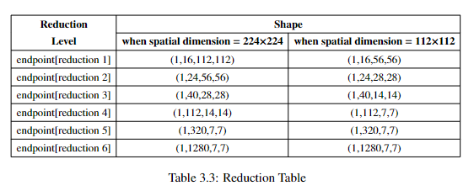

Slide 15
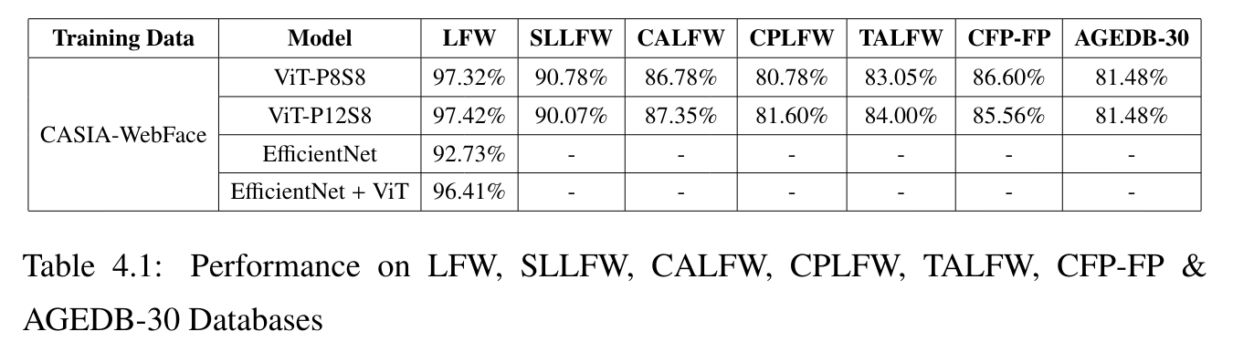
Results & Output

Slide 16
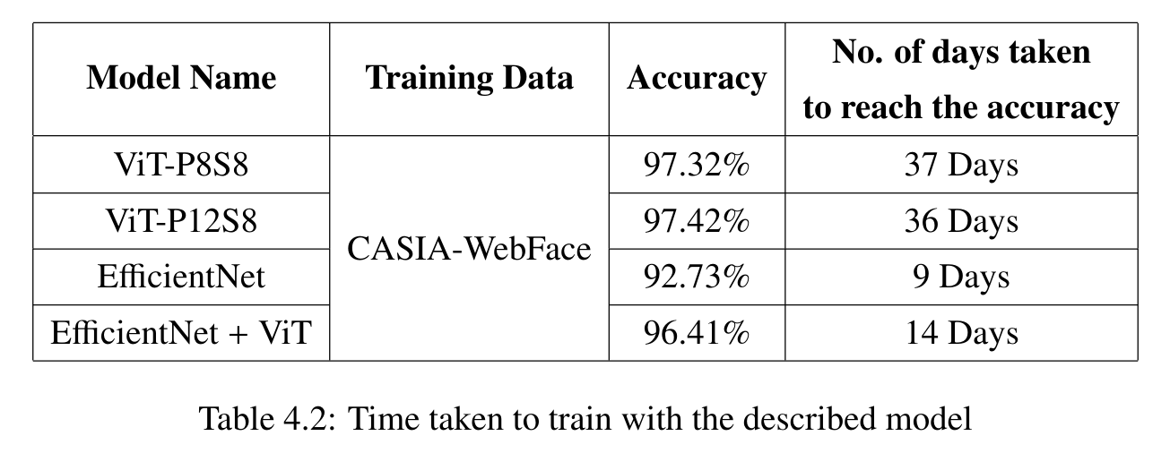
Results & Output

Slide 17
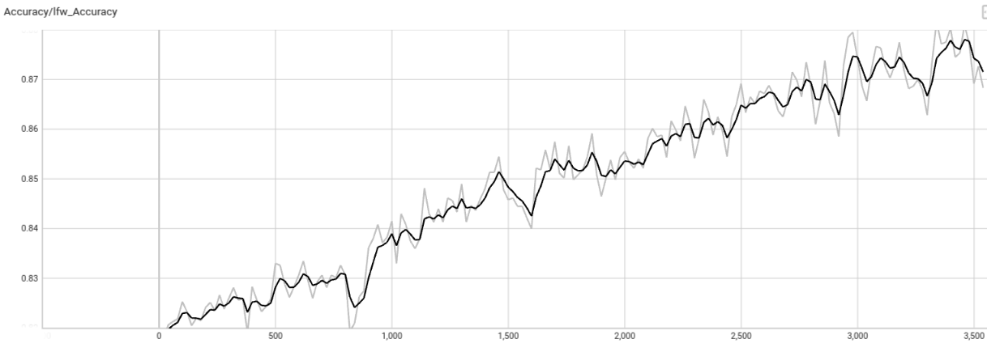
Accuracy / lfw-Accuracy

Slide 18
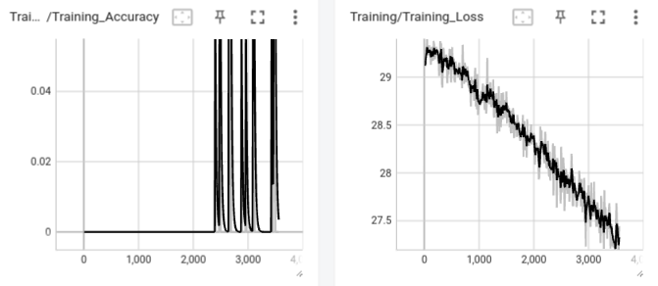
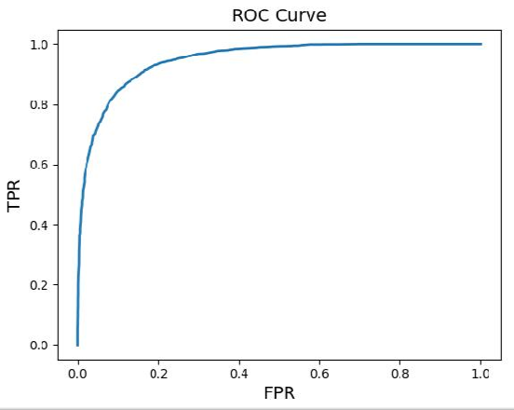
Training Accuracy & Training Loss
ROC Curve

Slide 19
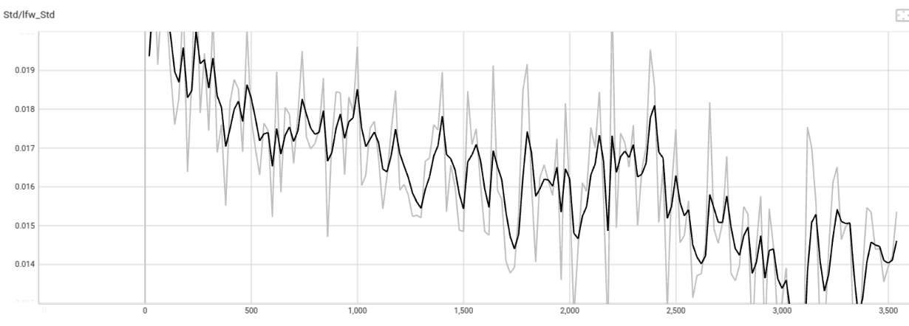
Std / lfw_Std

Slide 20
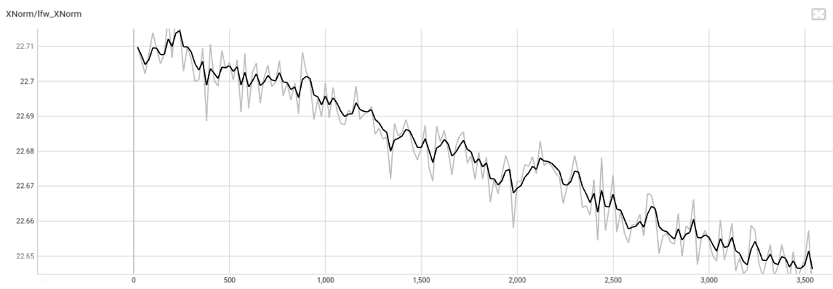
XNorm / lfw-XNorm

Slide 21
Conclusion
Despite encountering hardware issues we run the project in Google Colab using saved checkpoint, due to the computational limitations in Google Colab. After running for nearly 7200 batches for 16 epochs each, our model achieves nearly 96.41% accuracy on LFW Evaluation, where the ViT accuracy reaches upto 97.32% for a prolong computational run of 37 days. That means our experiment of transfer learn a model with EfficientNet & merged it into ViT, making the model EfficientViT becomes successful enough. Our goal is to unlock the full potential of the collaborative model and deliver performance closer to, or even surpassing, the merged capabilities of EfficientNet and Vision Transformer (ViT).
With the completion of our project, the success of our EfficientViT model stands as a testament to our dedication. Having merged the strengths of EfficientNet and ViT, we've achieved remarkable results, paving the way for future advancements in computer vision. As we reflect on our journey, we're proud to have surpassed the capabilities of our individual models and delivered performance beyond expectations.

